Slide 1
Matematyka na co dzień.
Zbiór zadań w języku angielskim dla uczniów klas IV-VI.
Martyna Żebrowska
uczennica klasy 8c Szkoły Podstawowej Nr 6
im. Orła Białego w Ostrołęce

Slide 2

Mathematics in every day life
Set of tasks for grades 4-6

Slide 3
introduction
This set of mathematical task was written for all pupils who want to play with maths and improve their English.
HAVE FUN!

Slide 4
4th grade

Slide 5
1
Michael is 137 cm tall.
Kazik is 18 cm shorter than him.
How tall is Kazik?

Slide 6
2
The chewing gum costs 1, 20 zl.
How much did Tomek pay for four of these chewing gums?

Slide 7
3
Zuzia gets 15 zlotys allowance,
and her older sister Dorota gets three times as much.
How much allowance does Dorota get?

Slide 8
4
Ola is the class treasurer.
She collects 8 zlotys for theatre tickets. Yesterday she collected 88 zlotys, today she collected 96 zlotys.
How many kids paid for the tickets?

Slide 9
5
Pink cookies are sold in larger packages of 20 pieces and smaller packages of 8 pieces.
Mom and Dad bought 3 bigger and 4 smaller packages of Pink cookies.
Dad already on the way home ate half of the cookies from the bigger package.
How many cookies are left?

Slide 10
6
The printing house printed 18,000 copies of the book, and after some time another 14,000 copies were printed.
Write down the total number of copies of this book printed.

Slide 11
7
A wealthy art collector bought a painting at auction for 20 thousand euros, a graphic for 40 thousand euros and a sculpture for 50 thousand euros.
How much money did he spend on that auction?

Slide 12
8
Ola has 10,50 zlotys.
Agata has three times more money than Ola.
How much money does Agata have?

Slide 13
9
Four marzipan bars and two lollipops cost a total of 13 zlotys.
A lollipop costs 1,50 zlotys.
How much is one marzipan bar?

Slide 14
10
At the sugar factory you can buy sugar in bags of 50 kilograms. In the warehouse, the sugar from such a bag is poured into packages containing half a kilogram of sugar.
How many packages do you get from one bag of sugar?

Slide 15
11
A banana and an apple together weigh half a kilo. An apple is 10 dag lighter than a banana.
How much does an apple weigh and how much a banana weigh?

Slide 16
12
Mrs Krysia bought 5 kg of washing powder. For each wash consumes 100 g of powder.
How many washes will this powder do?

Slide 17
13
The children of class 4b were given a ball. The teacher has announced that the fun will last 5 hours of lessons without interruption. The party started at 10:00 a. m.
What time does it end?

Slide 18
14
Calculate how much time will elapse from 11.05 today to 16.30 tomorrow.

Slide 19
15
The film that Kasia and Ola are going to watch lasts 1 hour and 35 minutes. The girls started watching at 6:15 p. m.
What time does the film end?

Slide 20
16
Karolina's dad wants to buy a car for 44350 zlotys. He sold the old car for 16400 zlotys, put in his savings or 8000 zlotys, and for the rest he took a loan from the bank.
How much money did he borrow from the bank?

Slide 21
17
The flight from Warsaw to New York lasted 12 hours. The aircraft flew at an average speed of 572 kilometers per hour.
How far did that plane travel?

Slide 22
18
Ola's parents have a strawberry plantation. In the first week they sold 165 kg of strawberries at 4 zloty per kilogram. In the second week they sold 230 kg, but the price of one kg decreased by 1 zloty.
How much money did Ola's parents make?

Slide 23
19
The owner of the hotel bought eight duvets and 18 pillows. He paid 1680 zlotys. He calculated that if he had bought the same number of duvets and twice as many pillows, he would have paid 1320 zlotys.
What would be the price of a duvet and
what would be the price of a pillow?

Slide 24
20
Andrzej had 12,35 zl.
On sweets he spent 5,80 zl.
How much does he have left?

Slide 25
21
Mrs. Eve bought 2,5 kg of pears, 3,4 kg of apples, and 1 kg of plums.
How much did these fruits weigh?

Slide 26
22
The reduced ticket to the zoo costs 4,50 zl and the normal ticket is twice as expensive.
How much was paid for 4 reduced tickets and 2 normal tickets?

Slide 27
23
There are 25 buttons in each box.
How many buttons are in 16 boxes?

Slide 28
24
Maja paid 3,15 zlotys for a bag of sweets, and Ola paid 16 gr less for her sweets.
How much did the girls pay for the sweets?

Slide 29
25
The plot in the shape of a square with a side of 30m was fenced with a net, every 2m in the fence there is a post.
Calculate how many posts are in this fence?

Slide 30
Asnwers 4th grade
1. 119 cm
2. 4, 80 zl
3.45 zl
4.15 zl
5. Jarek -50 postacrds, Marek -100 postcards
6. 82 cookies
7.32000
8.110 tys.euro

Slide 31
Answers 4th grade
9.31,50 zl
10.2,50 zl
11. 100
12. a banana -30dag, an apple -20 dag
13. for 50 washes
14. 13.30
15. 29 hours 25 minutes
16. 19950 zl

Slide 32
Aswers 4th grade
17. 6864 km
18. 1350 zl
19 a duvet -120 zl, a pillow -40 zl
20. 6,55 zl
21. 1 cm
22. 36 zl
23. 400

Slide 33
Answers 4th grade
24. 6,14 zl
25.60

Slide 34
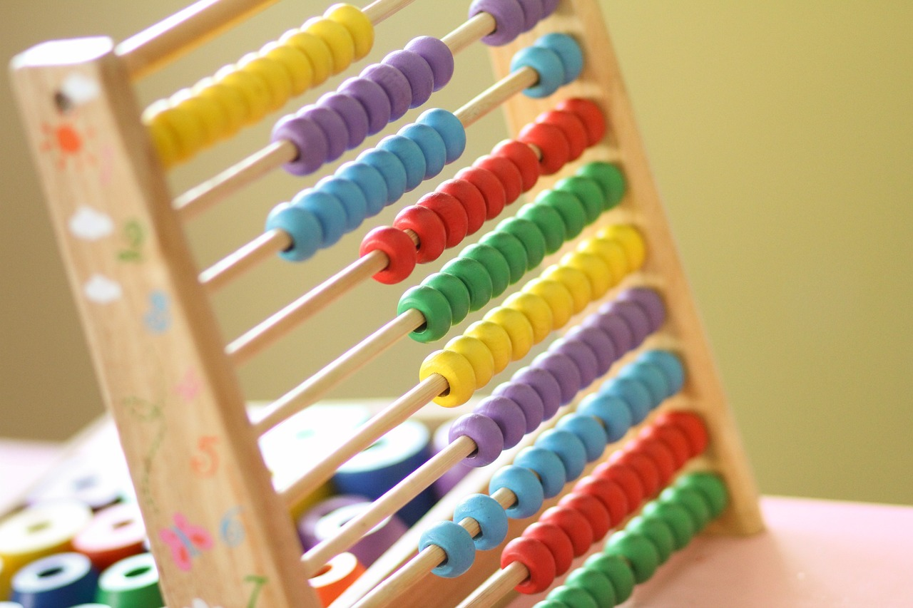
5th grade

Slide 35
1
Tomek is 10 years old,
his sister Magda is 2 years older than him,
their dad is 3 times older than Magda,
and mom is 4 years younger than dad.
How old is Mom?

Slide 36
2
In a 10 decagram bar of dark chocolate is 15 grams of water, fat 2 times more than water, and sugar 20 grams more than fat. The rest is made up of other components.
How much sugar is in five bars of this chocolate?

Slide 37
3
In fairyland, a year lasts 10 months, each month is 3 weeks, and one week has 5 days. The inhabitants of fairyland work 95 days a year.
How many days off per year do the inhabitants of this land have?

Slide 38
4
Mr. Andrzej ordered one pallet with bags of cement. A total of 1 ton of 400 kg of cement in 25 kg bags is placed on the pallet. One bag costs 12 zlotys, and the cost of transport is 78 zlotys.
How much zlotys will Mr. Andrzej pay
for cement and transport?

Slide 39
5
Kamila had 67 zlotys in her piggy bank, and her brother collected 3 times more money in his piggy bank than Kamila. How much money do they have to put in to buy a gift for mom for 310 zlotys?

Slide 40
6
In January of one year, Mr. Kowalski earned a total of 6000 zlotys, with 1/3 of this amount being spent on food, and 1/4 on fees.
How much money from January's earnings did Mr. Kowalski spend on food and how much on fees?

Slide 41
7
One-time bus ticket costs 1,25 zlotys. Waldek takes the bus about 100 times a month.
How much zlotys can Waldek save by buying a monthly ticket for 47,60 zlotys?

Slide 42
8
Magda wanted to weigh one match, but the weight was too inaccurate. Magda weighed a hundred matches. The matches weighed 12 grams.
How much did one match weigh?

Slide 43
9
A kilogram of Podlaskie cheese costs 12,25 złotys.
How much is 0.28 kilos of this cheese?

Slide 44
10
Three friends who buy chocolate for 4,95 zł.
How many zlotys would they have to put together for each of them to pay the same?

Slide 45
11
The 42. 195 km long marathon route was divided into 15 equal length sections. Each of the 15 students in the sports class has run one episode?
How many kilometers did each of them run?

Slide 46
12
Count how many rolls of 0,30 zlotys can be bought
for 11,40 zlotys.

Slide 47
13
The chocolate bar weighs 100 grams and costs 2,20 zlotys.
How much is a kilo of that chocolate?

Slide 48
14
The store owner bought 100 yogurts at a wholesale price of 1,80 zlotys and sold them at 2,15 a piece.
How much money did he make selling yogurt?

Slide 49
15
There were dishes on the table. The first bowl had 3 and 1/5 liters of juice, the second two times less than the first,
and the third four times less than the second.
How much juice was in the three bowls?

Slide 50
16
One tablet of vitamin C weighs for 1/20 gram.
How much do all the tablets weigh in a pack containing 75 vitamin C tablets?

Slide 51
17
Karolina made a fruit cocktail. She prepared it by adding 3/4 raspberry puree to 1 and 1/2 curdled milk. Then she decided to pour the cocktail into 4 jars. One jar has a capacity of 3/4 liters, the other jar of 1/2 liters, and the other two jars of 2/5 liters.
Will a cocktail fit into a pre-cooked jar?

Slide 52
18
Marek, Dorota, Zuzia and Tomek ate a huge pizza. Marek ate 1/3, dorota 1/6, Tomek 1/4 of the whole pizza, and Zuzia ate the rest.
What part of the pizza did Zuzia eat?

Slide 53
19
Gosia weighs as much less than Tosia, as Zosia weighs less than Lusia.
How much does Gosia weigh?

Slide 54
20
Mr. Kowalski had 1823 zlotys in his bank account, withdrew 1376 zlotys from his bank account, and then withdrew 500 zlotys from an ATM.
Does he have more or less than 1000 zlotys left in his account?

Slide 55
Answers 5th grade
32 years old
250g
55 days
750 zlotys
42 zlotys
For food 2000 zlotys, for fees 1500 zlotys
77,40 zl

Slide 56
Answers 5th grade
8.0,12 g
9.3,43 zl
10.1,65 zl
11.2,813 km
12.38
13.22 zl
14.35 zl
15.5 i 1/5 l

Slide 57
Answers 5th grade
16. 3 ¾ g
17. No
18. ¼
19. 41 ¼ kg
20 . Less

Slide 58
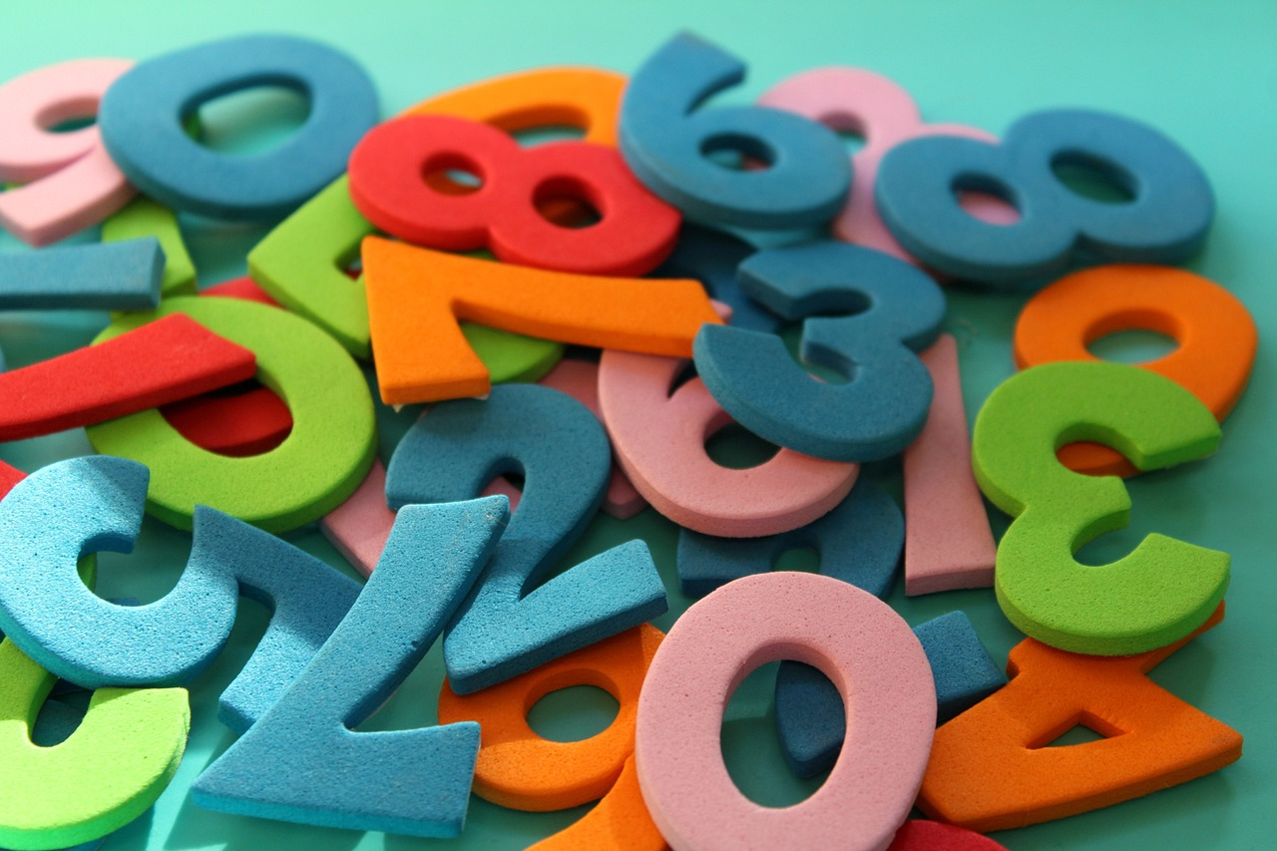
6th grade

Slide 59
1
Mr. Wojciech bought flower seedlings in 9 boxes of 16 seedlings each. paid 468 PLN, including 4 zloty for each box. Mr. Jerzy bought the same number of seedlings, in the same boxes, but 18 seedlings each and paid 464 PLN.
How much will Mr. Michał pay for his seedlings if he buys 6 boxes of 17 saplings each?

Slide 60
2
For the lottery organized in the kindergarten, balls of three sizes were purchased for 600 zlotys. A small ball cost 2. 50 zlotys. The price of a medium ball was three times higher than the price of a small ball. For half of the amount, the same number of small and medium balls were bought. For the rest of the money, large balls were bought for 12,50 zloty each.
How many balls were bought in total?

Slide 61
3
At the school festival tickets were sold in three colours: green for 6 zlotys, white for 5 zlotys, red for 7 zlotys. Mr. Wojciech bought 10 tickets and paid 51 zlotys.
How many tickets were green among those which Mr. Wojciech bought??

Slide 62
4
Dad's building a decorative fence among a rectangular plot of 3 acres. The longer side is 24 m. Dad has already built a fence with a total length of 41. 5 m.
How many meters of fence is left for him?

Slide 63
5
Mr. Jerzy made a bicycle trip around Europe, which lasted 55 days. He left on a Saturday morning.
What day of the week did George come back?

Slide 64
6
According to the timetable, the train departs at.14:35 from Wroclaw should arrive in Warsaw at 18:35. due to technical reasons he left Wroclaw a bit later, but on the way he made up half of the delay and in Warsaw it was 19:03.
What time did the train leave Wroclaw?

Slide 65
7
Mr. Wojciech wants to visit Paris. He is going to get there by train, which leaves Warsaw at 23. 05 and is there the next day
at 20:05, or take a plane that leaves Warsaw at 6.:25 and is in the French capital at 8.:55.
How much longer would it take to travel by train than by plane?

Slide 66
8
Mr. Jerzy has 320 km to go by car. His car burns an average 5, 5 liters of fuel per 100 km.
How many liters of fuel does George need to cover that distance?
How much will the trip cost if a liter of petrol costs 4. 80 PLN?

Slide 67
9
Wojtek cycled 36 km less on Saturday than on Friday. In total, during these two days he covered a route of 84 km.
How many times did he drive longer on Friday than on Saturday?

Slide 68
10
A group of ten tourists came to the hostel for a meal. Some of them ordered only borscht, the portion of which cost 4 zlotys. The others ordered only pancakes at 7 zlotys per serving. For the whole order 52 zlotys was paid.
How many people ordered borscht and how many pancakes?

Slide 69
11
Mr. Jerzy filled his car with 15 liters of fuel and paid 72 zloty. After driving a few kilometers he passed a gas station where the same fuel was cheaper. He calculated that for 72 zlotys he could buy 1 liter more fuel at this station.
How much cheaper was a liter of gasoline at the second gas station than at the first?

Slide 70
12
Mrs. Katarzyna bought 6 cups of her favorite yogurt. The next day, one yogurt cost 35 cents less, so she could buy two more yogurts for the same amount. She decided to buy 7 cups of yogurt.
How much did she pay?

Slide 71
13
Marek left home for a bike trip at 9. 10 am. After driving 8 km, he rested for 20 minutes by the stream. He came home the same way at one o'clock. 10. 50.
What was the average speed of Marek?

Slide 72
14
How much did Marta pay for all the cookies if she bought: 0,3 kg of peanut cookies at the price of 11 zlotys per kilogram, 0,25 kg of coconut cookies at 18 zlotys per kilogram and half a kilogram of lemon cookies at the price of 15 zlotys per kilogram?

Slide 73
15
How much will Mrs. Zosia pay for the following purchases: 2 kg of beetroot at 1,80 zlotys per kilogram, 3 packs of tea at 2,40 zlotys per pack and 8 rolls at 0,40 zlotys per piece?

Slide 74
Answers 6th grade
330 zl
84
One
31,5 m
On Thursday
About 15.01
6,4 times

Slide 75
Answers 6th grade
8. 17,6 l, 84,48 zl
9. 2,5 times
10. borscht -6 people, pencakes- 4 people
11.About 30 gr
12. 7,35
13.12 km/h
14.15,30 zl
15.14 zl

Slide 76
Matematyka na co dzień –zbiór zadań z matematyki w języku angielskim dla uczniów klas IV-VI został napisany celem realizacji projektu edukacyjnego w ramach otrzymanego stypendium dla uczniów VII i VIII klas szkół podstawowych oraz uczniów liceów ogólnokształcących w Województwie Mazowieckim w roku szkolnym 2022/2023 w ramach projektu –Mazowiecki program stypendialny dla uczniów szczególnie uzdolnionych –najlepsza inwestycja w człowieka.

Slide 77
Zdjęcia zawarte w zbiorze zadań pochodzą ze strony www.pixabay.com –strona z darmowymi obrazami.

